Slide 1
Machine Learning For Fun!
Section 1

Slide 2
First Things First
How many does not have laptops?
How many know how to code?
How many have used Python before?
How many has done cool stuff with machine learning? (impressive!)
Be sure to enter your details on the sign-up sheet
Questions? Shoot off!
Note: All materials used in this course will be available on https://github.com/aslamahrahman

Slide 3
Installation Checklist
Windows & Mac users
Install Anaconda (Python comes along with it)
Download .exe from https://www.anaconda.com/download/
Follow installation instructions on official website
Install Pandas, Matplotlib & Scikit-learn
Open Anaconda command prompt
$conda install pandas
$conda install matplotlib
$conda install scikit-learn
Linux users
Open terminal window, update Python & Pip:
$python –m pip install --upgrade pip setuptools wheel
Install Pandas, Matplotlib & Scikit-learn
$pip install pandas
$pip install matplotlib
$pip install scikit-learn
Trouble? Ask! Still more trouble? Google!

Slide 4
THE EXCITING STUFF
What is the deal with machine learning?

Slide 5
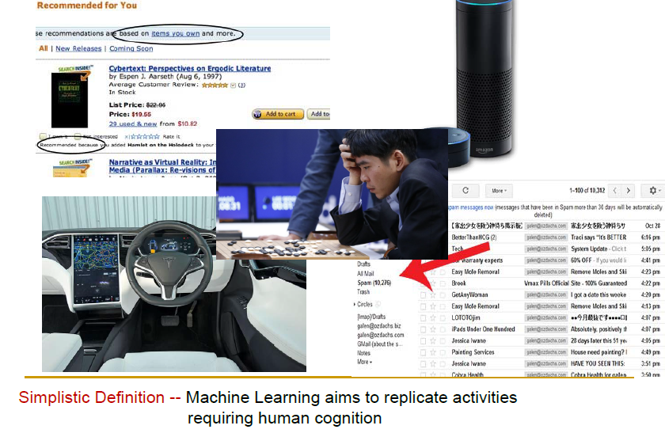
Where is Machine Learning?

Slide 6
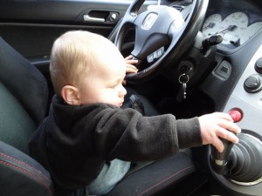
How to learn to drive – Thought exercise
Notes:
Obstacle detection
Line following
What to do in an accident? Human/tree?
How to detect things
How to park
How to maintain different trains
When to shift gears? When can you accelerate

Slide 7
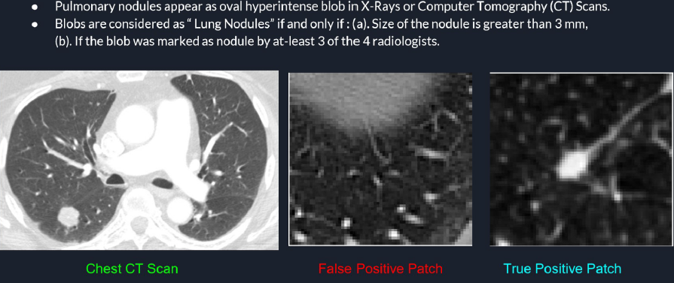
Why do we need Machine Learning?
Notes:
40% chance that a lung nodule can be cancerous
Image processing problem? Difficult to measure size. Depends on what angle to took the cross sections. Not a circle!
High chance of false positive. What is false positive?

Slide 8
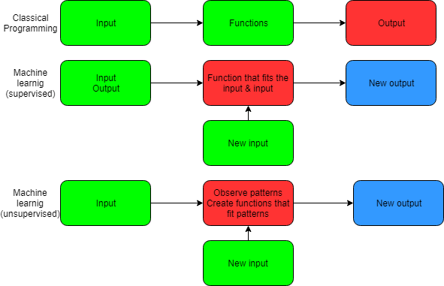
What does machine learning do?
Notes:
Example of how you do mcq by trial and error

Slide 9
Linear regression
Let us head over to the Python Jupyter Notebook!
More practice? Checkout datasets from:
http://vincentarelbundock.github.io/Rdatasets/datasets.html
https://archive.ics.uci.edu/ml/datasets.html?format=&task=reg&att=&area=&numAtt=&numIns=&type=&sort=nameUp&view=table
Notes:
Given a dataset, how would you start analysing it?
Start with simple curve fitting for y=ax+b to ax^2+bx+c (feature extraction)
Do with example of an interesting dataset
Talk about feature identification & extraction
What function should it fit? How do we tell them what to do? Hence loss function
How do you judge how good a model is?

Slide 10
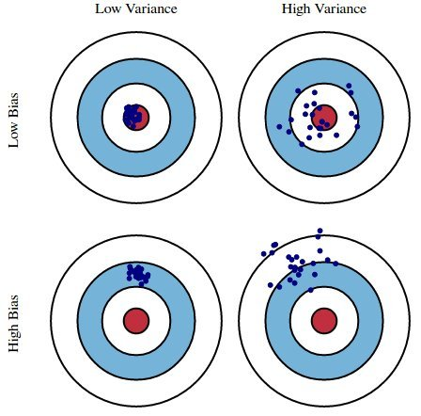
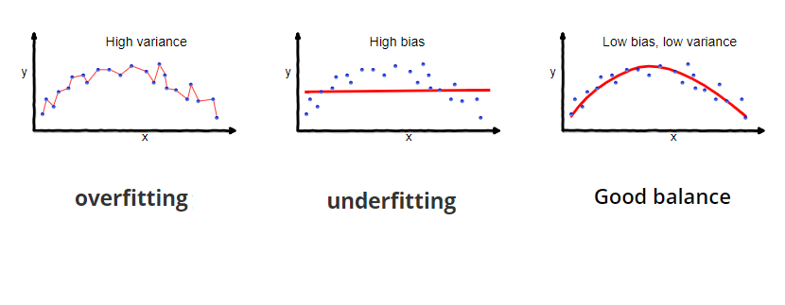
How to evaluate your model?
Notes:
Training your model
Bias variance tradeoff
Tuning parameters
Bias variance flowchart
Short learning curve
ID5030_04

Slide 11

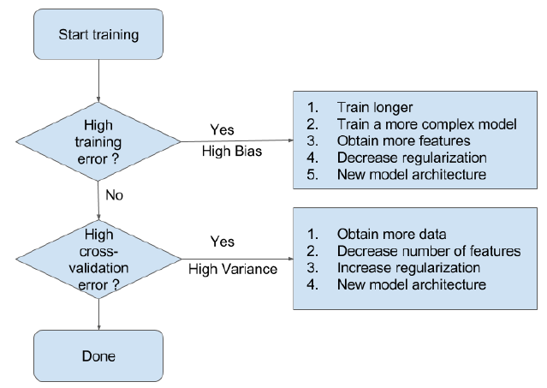
ML MODEL

Slide 12
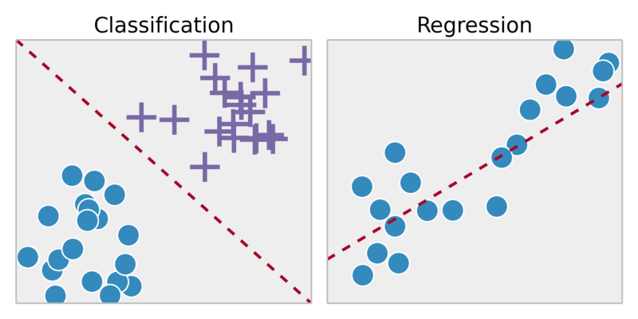
Two problem types in supervised learning
Regression
Fit the data!
Has a real number associated with each data point
Techniques: linear methods, neural networks, decision trees, random forests, support vector machines
Classification
Split the data!
Has a class/category associated with each data point
Techniques: all techniques in regression + clustering algorithms, autoencoders, EM algorithm etc
Notes:
Third class of reinforcement learning in autonomous robots
Rewards scheme

Slide 13
Machine Learning For Fun!
Section 2

Slide 14
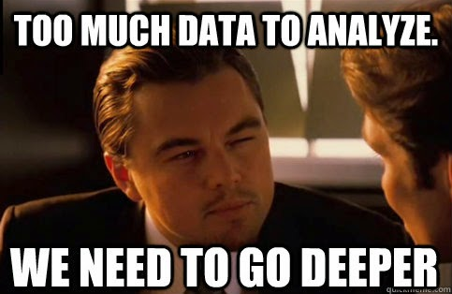
Notes:
It is time to get deep
Curse of dimensionality
You don’t know about the nature of features and your dataset is huge
What do you do? Deep learning! (Universal function approximator)

Slide 15
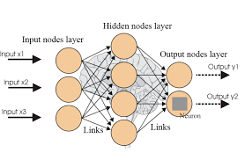
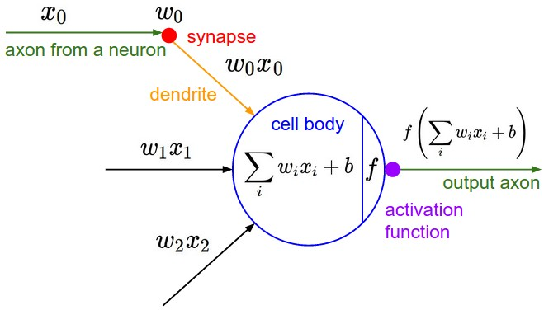
The beast that is Artificial Neural Network
Notes:
Brief about neural networks
Curse of dimensionality? Too many
Wanna see a cool example? How would you identify numbers?
Image classification and semantic segmentation
Can you use the same loss function? Use logistic regression!

Slide 16

TensorFlow Time!
Open source machine learning framework
Uses computational graphs for data flow
Multiple reusable libraries
Available on Python, C/C++, Java, Go
CPU, GPU, TPU support

Slide 17
Machine Learning For Fun!
Section 3

Slide 18
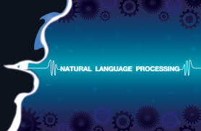
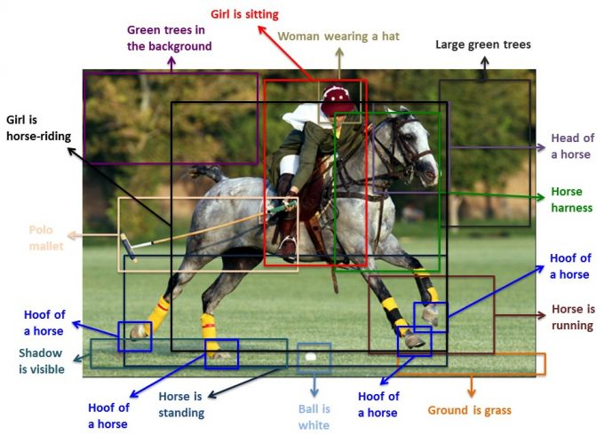
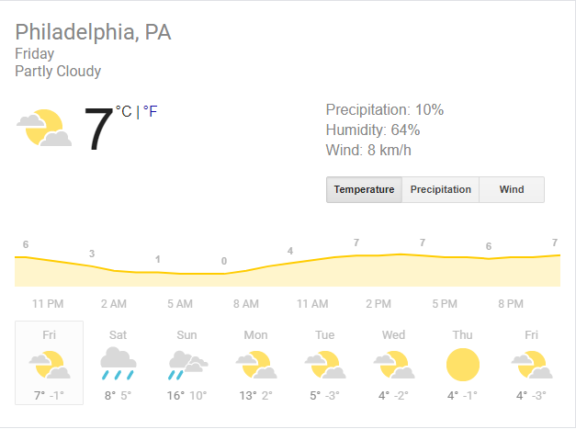
How to predict the future? How to understand literature?
Notes:
Deeper into deep learning
Predict several timesteps
RNNs
Text autoprediction in google
Weather prediction, otherwise solving complicated multiple fluid flow equations
Energy consumption prediction (time series data in general)
Picture labelling, just like how to learn to join words to make meaningful sentences (no meaning though)

Slide 19
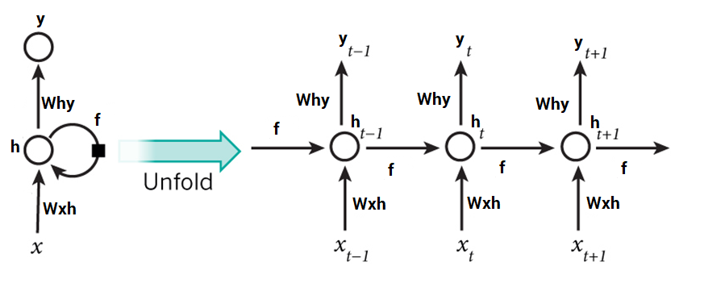
Recurrent Neural Networks

Slide 20
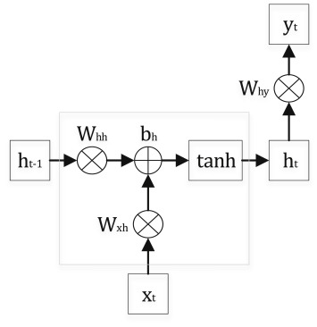
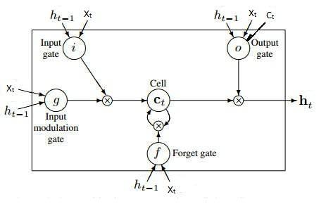
What happens inside an RNN cell?
Vanilla RNN LSTM
Notes:
https://towardsdatascience.com/text-predictor-generating-rap-lyrics-with-recurrent-neural-networks-lstms-c3a1acbbda79

Slide 21
Few cool examples
https://github.com/gsurma/text_predictor
https://github.com/GarrettHoffman/lstm-oreilly/blob/master/Stock%20Market%20Sentiment%20with%20LSTMs%20and%20TensorFlow.ipynb

Slide 22
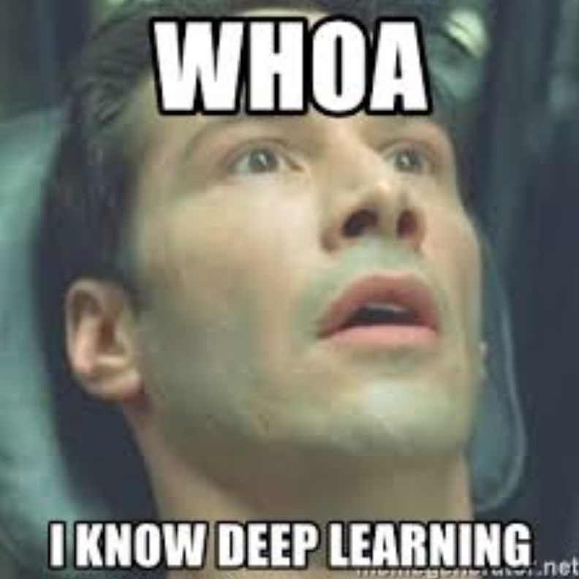

Slide 23
Resources GALORE
Note: All materials used in this course will be available on https://github.com/aslamahrahman

Slide 24
Online courses
Machine Learning by Andrew Ng on Coursera (Professor at Stanford University)
Pretty hardcore stuff, but a great place for really diving into the basics of creating ML algorithms
Data science, Deep Learning and Machine Learning with Python by Udemy
A wholistic resource of a lot of machine learning techniques
Focus on implementation training and available tools such as Keras, Apache Spark
Applied Machine Learning in Python on Coursera
Applied AI with Deep Learning, Coursera
https://medium.freecodecamp.org/every-single-machine-learning-course-on-the-internet-ranked-by-your-reviews-3c4a7b8026c0

Slide 25
Blogs, Communities, Competitions
Kaggle.com
AnalyticsVidhya.com
Drivendata.org (for projects with a social angle)
Hackerrank.com
Medium.com blogs
Free code camp blogs
Any search result on your doubt on the first Google page! (Remember not to get lost)

Slide 26
Ultimate Machine Learning Cheat Sheets
https://ml-cheatsheet.readthedocs.io/en/latest/
https://medium.com/machine-learning-in-practice/cheat-sheet-of-machine-learning-and-python-and-math-cheat-sheets-a4afe4e791b6

